Slide 1

Flight Price & Customer Satisfaction Prediction Projects
Welcome to our comprehensive presentation on two innovative machine learning projects in the travel industry. We'll explore how predictive analytics can transform flight pricing strategies and enhance customer satisfaction through data-driven insights.
These projects demonstrate the power of combining Python, Streamlit, and MLflow to create practical applications that solve real business problems in the travel and tourism domain.
by Saranya S

Slide 2
Project Overview
Flight Price Prediction
Customer Satisfaction Prediction
A regression-based project that predicts ticket prices based on multiple factors including departure time, route, and airline type.
A classification project that predicts passenger satisfaction levels based on service ratings, demographics, and travel details.
Uses historical flight data to build models that can forecast prices, helping travelers plan trips more effectively and assisting businesses with budgeting.
Helps airlines identify factors influencing customer experience and develop targeted strategies to improve services and retention rates.

Slide 3

Technical Skills & Tools
Programming & Analysis
Machine Learning
Python for data processing and analysis
Regression models for price prediction
Data cleaning and preprocessing techniques
Classification models for satisfaction analysis
Feature engineering to enhance model performance
Model evaluation and optimization methods
Deployment & Tracking
Streamlit for interactive web applications
MLflow for experiment tracking and model registry
Visualization techniques for data presentation

Slide 4



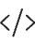

Flight Price Prediction: Problem Statement
Core Challenge
Build an end-to-end solution to predict flight ticket prices based on multiple factors such as departure time, source, destination, and airline type.
Data Requirements
Process, clean, and perform feature engineering on the provided flight dataset to prepare it for model training.
Technical Implementation
Train regression models to predict flight prices and deploy them in a user-friendly Streamlit application with MLflow integration.
User Experience
Create an interface allowing users to input filters (route, time, and date) and receive accurate price predictions for their flights.

Slide 5





Flight Price Prediction: Business Use Cases
Traveler Planning
Travel Agency Optimization
Corporate Travel Budgeting
Helps individuals predict flight prices based on their preferences, enabling better trip planning and budget management.
Assists agencies in price optimization and developing effective marketing strategies based on predicted price trends.
Enables businesses to forecast and budget for employee travel expenses with greater accuracy.
Airline Strategy Development
Supports airlines in identifying pricing trends and optimizing their pricing strategies to maximize revenue.

Slide 6








Flight Price Prediction: Dataset Overview
Temporal Data
Location Information
Date of Journey, Departure Time, Arrival Time, Duration
Source, Destination, Route
Journey Specifics
Airline Details
Total Stops, Duration
Airline name, Additional Info
The Flight_Price.csv dataset contains comprehensive information about flights, including temporal data, location information, airline details, and journey specifics. This rich dataset provides the foundation for building accurate price prediction models.

Slide 7




Flight Price Prediction: Technical Approach
Data Preprocessing
Load and clean the dataset by removing missing or duplicate entries
Convert date and time columns into standard formats
Perform feature engineering to calculate new features like price per minute
Model Development
Conduct exploratory data analysis to identify trends and correlations
Train regression models (Linear Regression, Random Forest, XGBoost)
Log experiments and metrics using MLflow for model comparison
Application Development
Build an interactive Streamlit app with visualizations of flight price trends
Implement filtering by route, airline, and time
Integrate MLflow model registry for prediction functionality

Slide 8



Customer Satisfaction Prediction: Problem Statement
Challenge Identification
Build a classification model to predict customer satisfaction levels for airline passengers
Data Processing
Clean, process, and engineer features from passenger feedback and service ratings
Solution Deployment
Create a Streamlit application that predicts satisfaction based on user inputs
This project aims to help airlines understand and predict customer satisfaction by analyzing various factors that influence the passenger experience. By identifying key satisfaction drivers, airlines can implement targeted improvements to enhance overall service quality.

Slide 9








Customer Satisfaction Prediction: Business Use Cases
Strategic Decision Making
Inform management decisions for service improvements
Targeted Marketing
Identify and segment customer groups for personalized campaigns
Service Enhancement
Pinpoint specific areas needing improvement
Customer Retention
Predict and address potential dissatisfaction before it leads to churn
By accurately predicting customer satisfaction, airlines can proactively address issues, enhance services where needed, and develop targeted marketing strategies. This leads to improved customer retention, stronger brand loyalty, and ultimately increased revenue through repeat business.

Slide 10
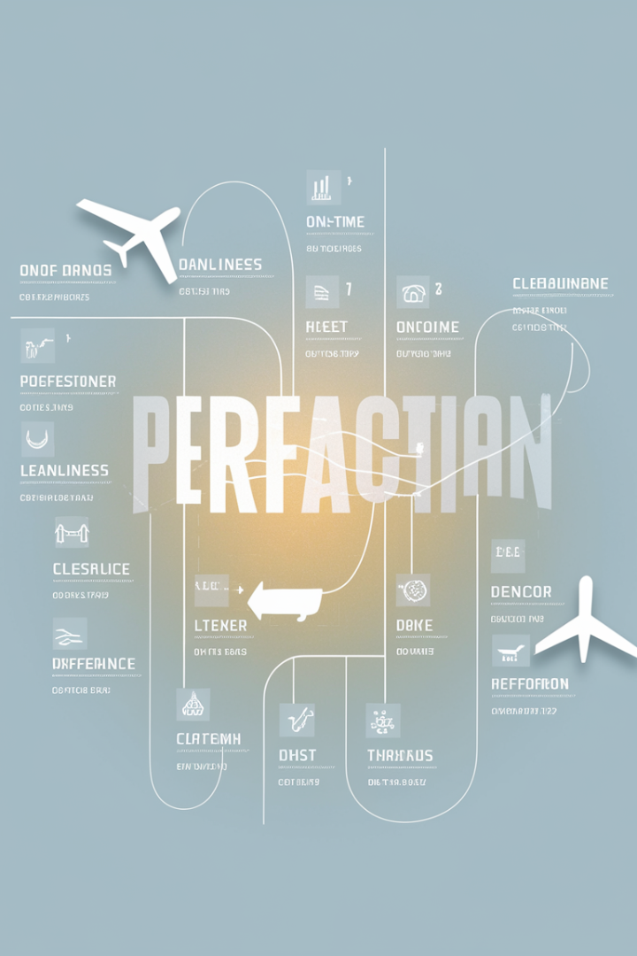
Customer Satisfaction Prediction: Dataset Overview
Category
Features
Demographics
Gender, Age, Customer Type
Travel Details
Type of Travel, Class, Flight Distance
Pre-flight Services
Online Booking, Check-in Service, Gate Location
In-flight Services
WiFi, Food/Drink, Entertainment, Seat Comfort
Operational Metrics
Departure/Arrival Delays, Baggage Handling
Target Variable
Satisfaction (Satisfied, Neutral, Dissatisfied)
The Passenger_Satisfaction.csv dataset contains a comprehensive set of features covering demographics, travel details, and service ratings across various touchpoints of the passenger journey. This rich dataset enables detailed analysis of factors influencing customer satisfaction.

Slide 11




Customer Satisfaction Prediction: Technical Approach
Data Preprocessing
Clean the dataset by handling missing values and duplicates. Encode categorical variables like gender and customer type. Normalize numerical features to ensure consistent scaling across all variables.
Model Development
Perform exploratory analysis to understand feature relationships. Train classification models including Logistic Regression, Random Forest, and Gradient Boosting. Track experiments using MLflow to compare model performance.
Application Development
Build a Streamlit app that visualizes satisfaction trends and allows users to input passenger details to receive satisfaction predictions. Integrate with MLflow's model registry for seamless deployment.

Slide 12
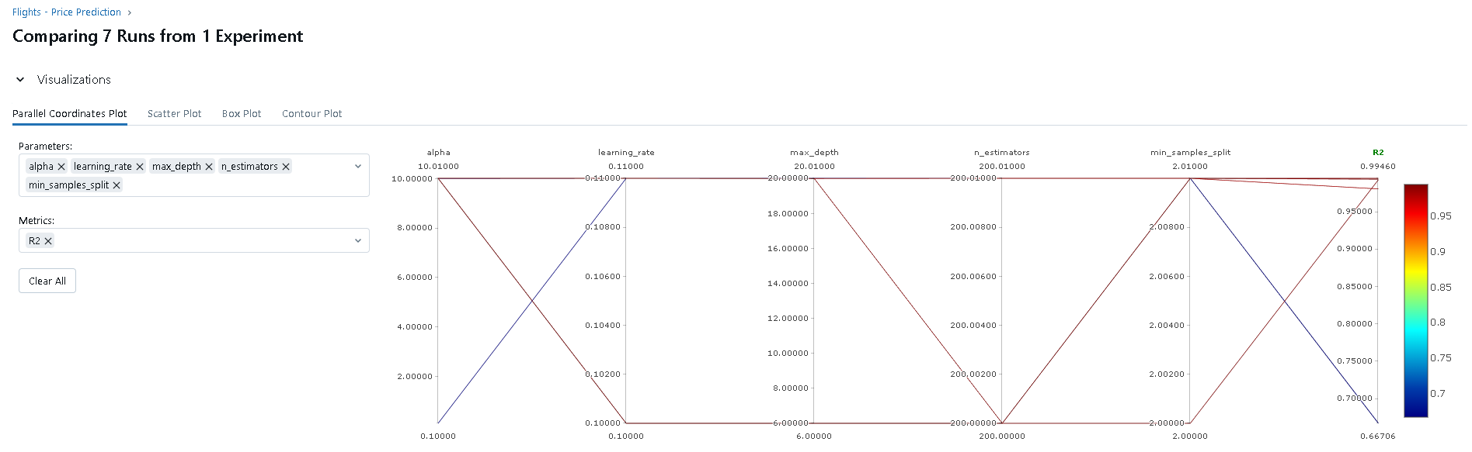
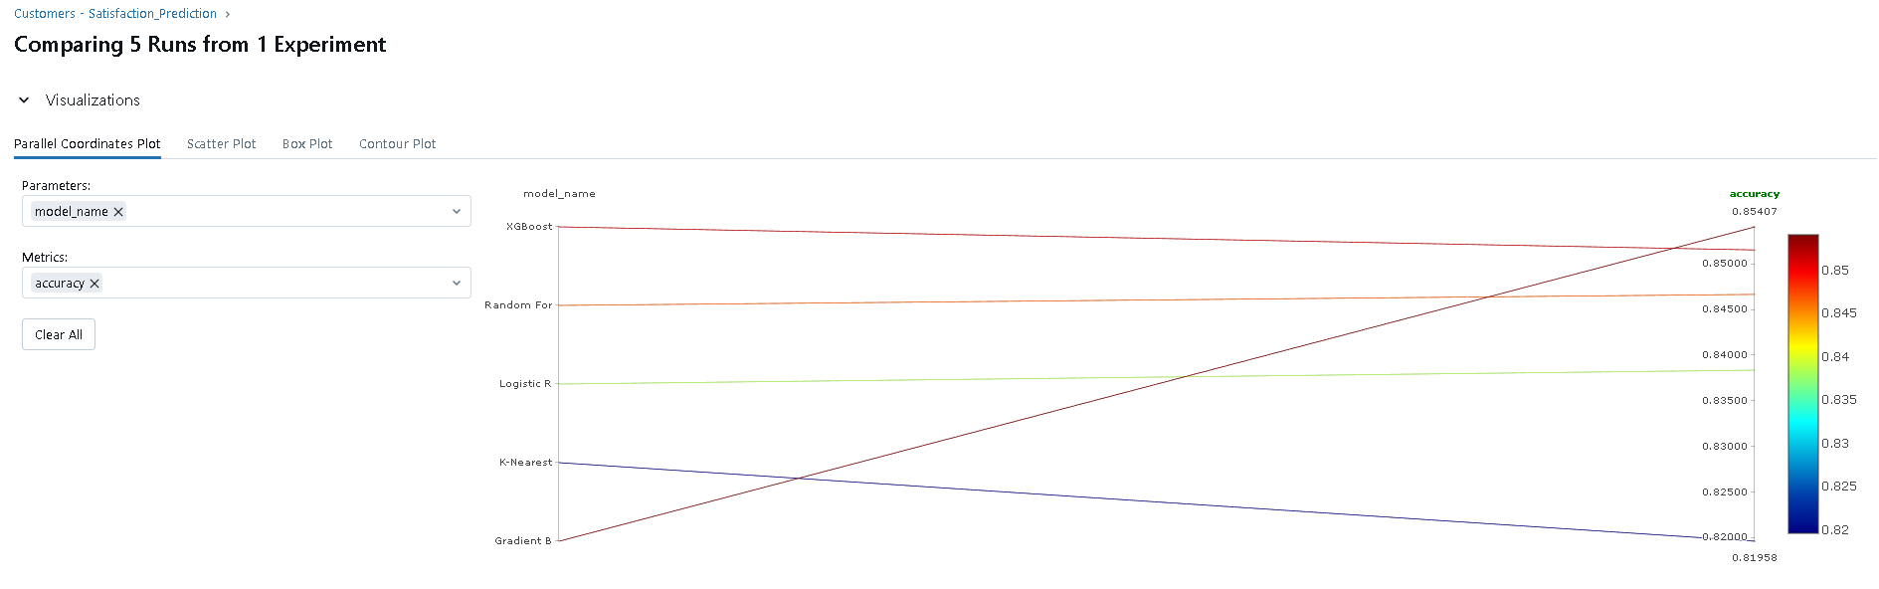
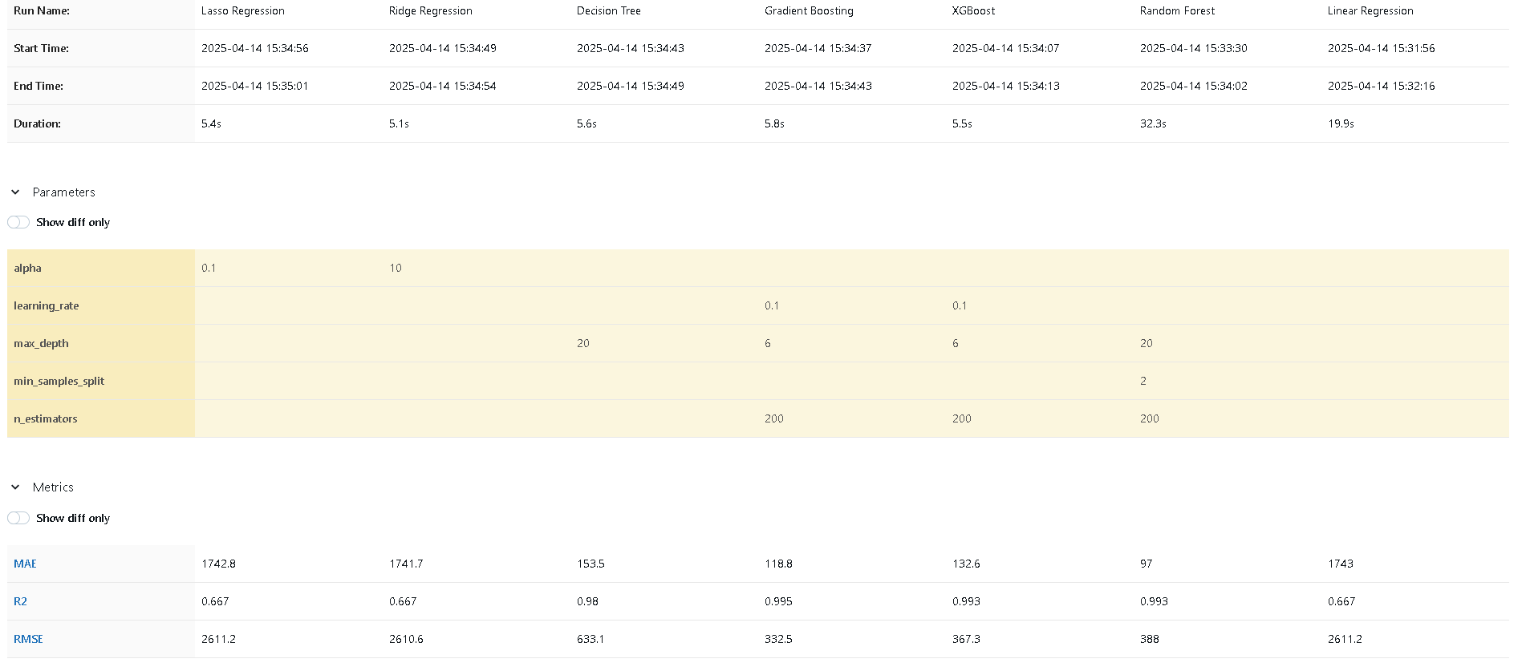
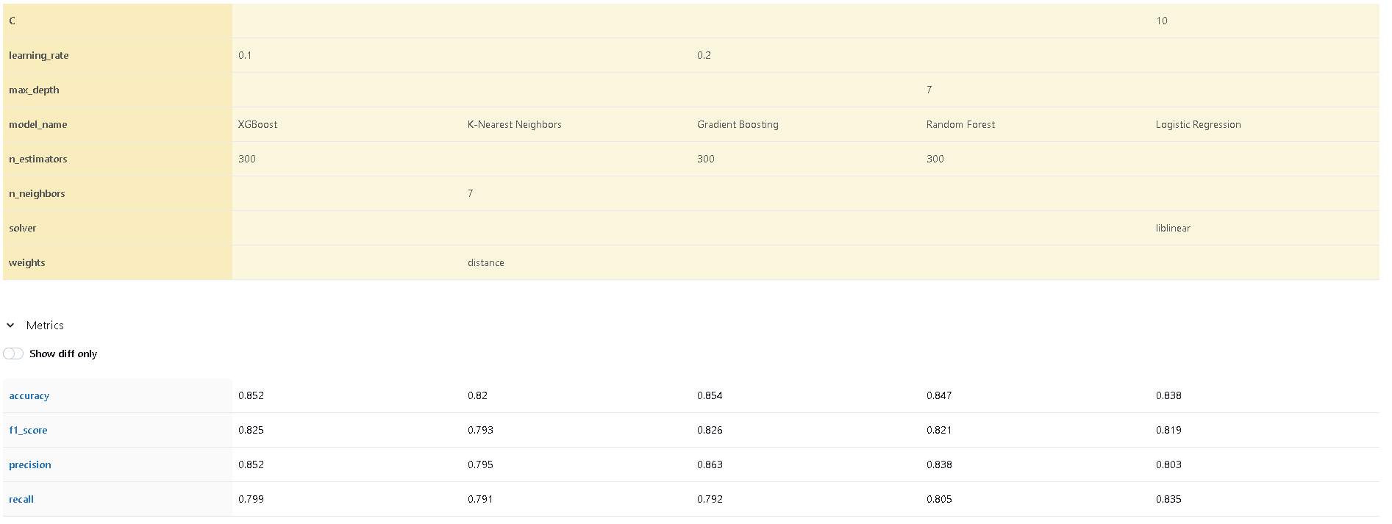
MLflow Integration Benefits
Experiment Tracking
MLflow automatically logs parameters, metrics, and artifacts for each model run, creating a comprehensive record of all experiments. This enables easy comparison between different models and hyperparameter configurations.

Slide 13
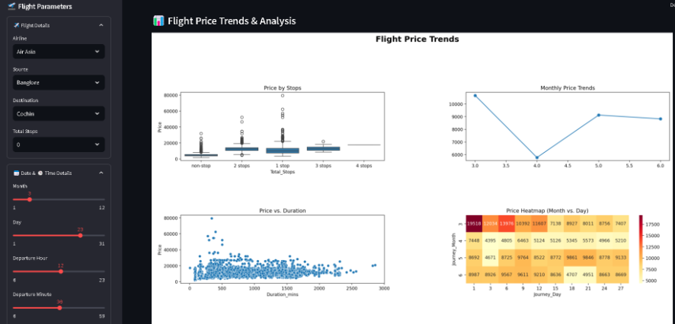
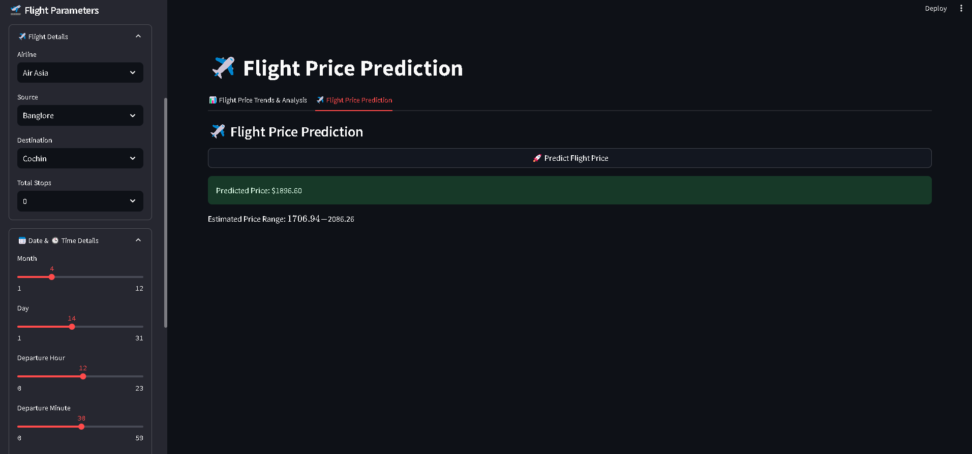
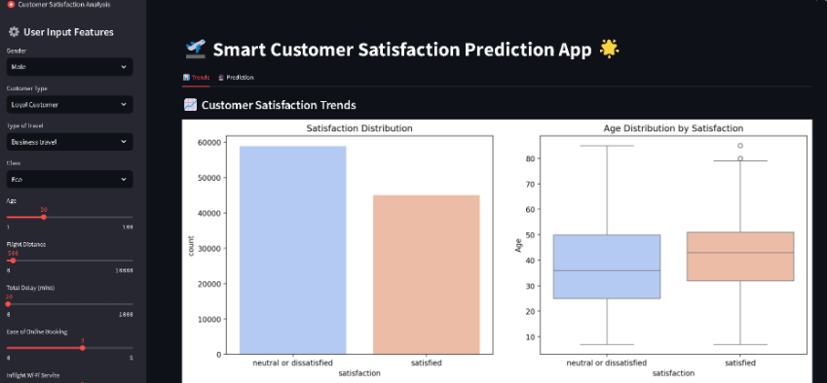
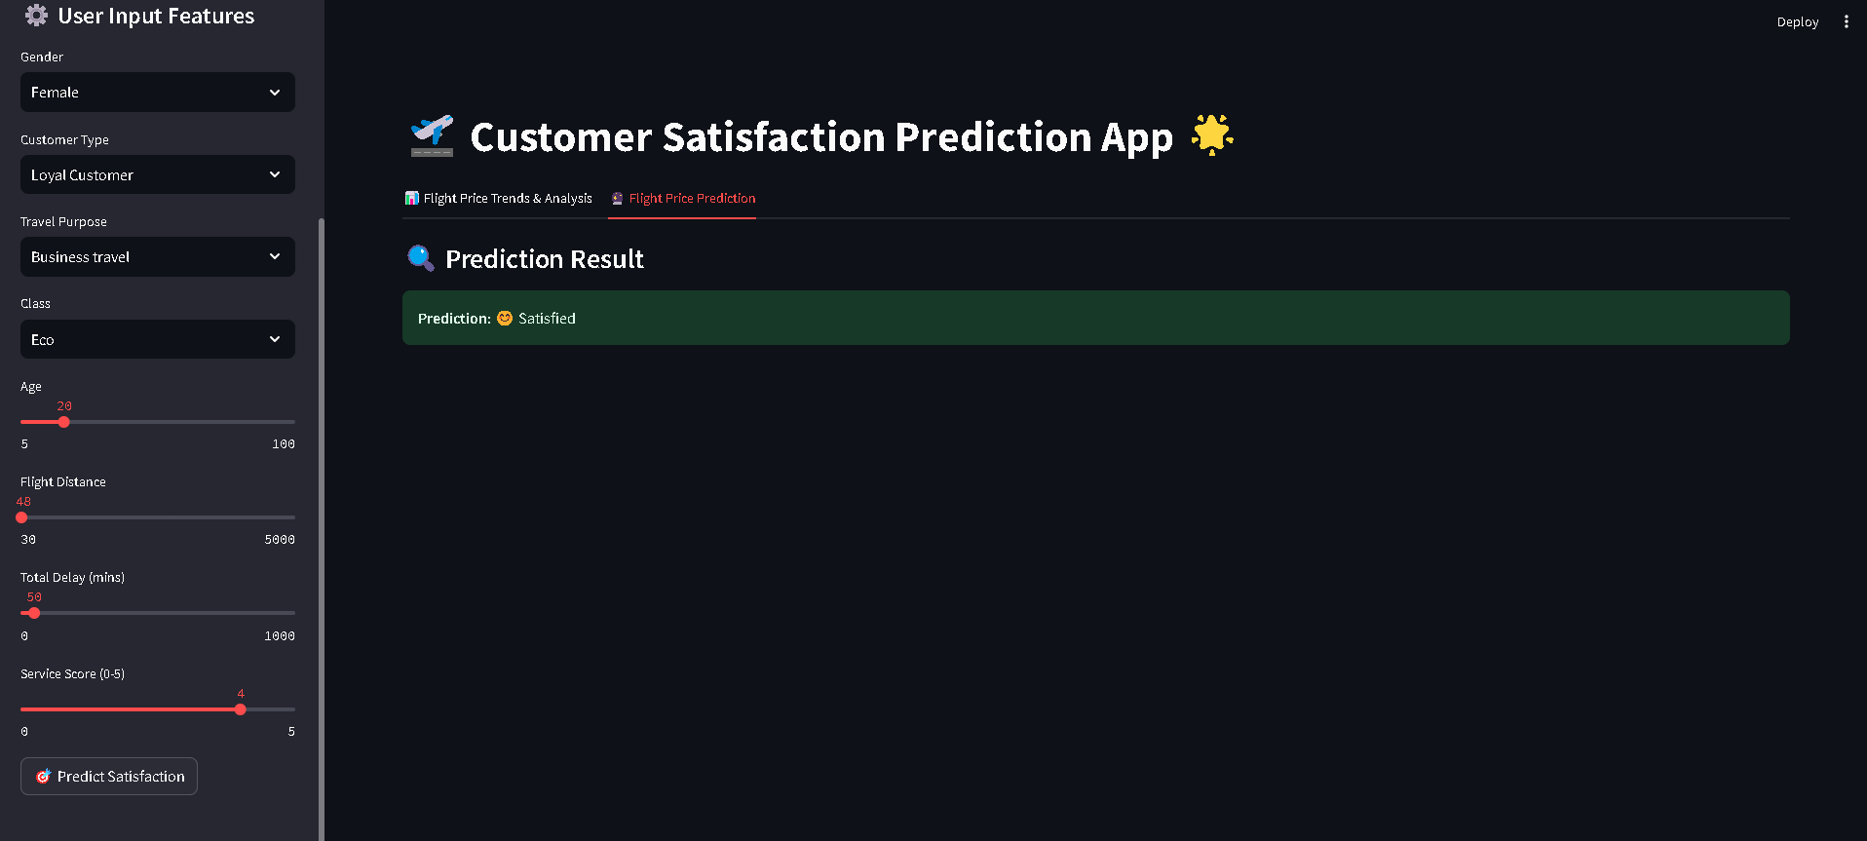
Streamlit Application
Our Streamlit applications provide intuitive interfaces for both projects. Users can explore data visualizations, interact with prediction models, and gain insights through interactive features. The flight price prediction app allows filtering by route, airline, and time, while the customer satisfaction app enables input of passenger details and service ratings to predict satisfaction levels.

Slide 14

Project Deliverables
Clean Datasets
Processed CSV files ready for analysis and modeling
ML Models
Trained regression and classification models tracked in MLflow
Applications
Interactive Streamlit apps for prediction and visualization
Python Scripts
Code for data processing, modeling, and application development
All deliverables are thoroughly documented with clear instructions for setup and usage. The code follows best practices for readability and maintainability, making it easy for future developers to understand and extend the functionality.

Slide 15
Business Impact & Conclusion
Revenue Optimization
Data-Driven Insights
Better pricing strategies and improved customer retention lead to increased revenue
Actionable intelligence from predictive models informs business decisions
Enhanced Customer Experience
Operational Efficiency
Targeted improvements based on satisfaction predictions increase loyalty
Better forecasting and resource allocation improve overall efficiency
These projects demonstrate how machine learning can transform business operations in the travel industry. By leveraging predictive analytics for flight pricing and customer satisfaction, airlines and travel agencies can make data-driven decisions that enhance both the bottom line and the customer experience.
The combination of Python, Streamlit, and MLflow creates a powerful toolkit for developing, deploying, and maintaining machine learning solutions that deliver real business value.

